Slide 1
CLEAN ROOM SOFTWARE ENGINEERING
CSC-532
By
Srinivasa Yanaparti

Slide 2
Introduction:
It Goes against the traditional approach of software engineering.
To avoid dependence on cost defect removal process
Its process model incorporates the statistical quality verification of code increments as they accumulate into a system.

Slide 3
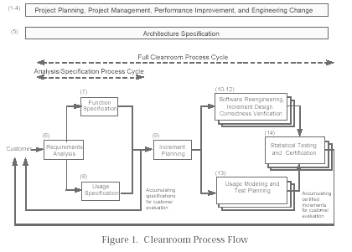
Clean room process Flow:

Slide 4
Clean room Management Processes:
Project Planning Process
Project Management Process
Performance Improvement Process

Slide 5
Clean Room Specification Processes:
Requirement Analysis Process
Functional Specification Process
Usage Specification Process
Architecture Specification Process
Incremental Planning Process

Slide 6
Clean Room development Processes:
Software Reengineering Process
Increment Design Process
Correctness Verification Process

Slide 7
Clean Room Certification Processes:
Usage Modeling and Test Planning Process
Statistical Testing and Certification process

Slide 8
Advantages of CSE:
Improve the quality
Increase productivity
Improve software maintainability

Slide 9
Disadvantages of CSE:
Too theoretical ,too mathematical and plain too radical for software development.
Denying the programmer access to the compiler is unrealistic and can be counterproductive.

Slide 10
Conclusion:
The CSE methodology uses controlled and measurable statistics to eliminate or avoid as many defects as possible before software execution.
It supports prototyping , object orientation and reuse.
It can be applied to new system as well as existing systems.

Slide 11
References:
Linger, R.,” Clean room Process Model” IEEE Software , March 1994, pp.50-58.
Richard C.linger , Carmen J. Trammell- “Clean room software Engineering Reference model Version 1.0”, November 1996
Harish Ananthpadmanabhan, Chetan Kale, Mujtaba Khambatti, Ying Jin , Shaum taufiq Usman, Shu Zhang – “ Clean room Software Development” , Arizona state University.
Roger S.PressMan – “Software Engineering –A Practitioner’s Approach (4/e).”

Slide 12
Questions?

